Slide 1
Transmission Media
cosc350

Slide 2
Introduction
transmission media, including wired, wireless, and optical media
taxonomy of media types
basic concepts of electromagnetic propagation
the effect of shielding with respect to interference and noise
the concept of capacity

Slide 3
Guided and Unguided Transmission
Categorization of transmission media
Two approaches:
By type of path
By form of energy
Physical Media
Guided (wired): copper wiring, optical fibers
Unguided (wireless): radio

Slide 4
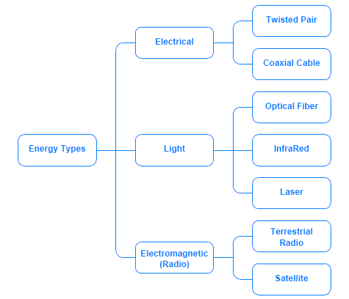
A Taxonomy by Forms of Energy
The diagram shows how physical media can be classified according to the form of energy used to transmit data

Slide 5
Background Radiation and Electrical Noise
Electrical current needs a complete circuit
two wires to form a circuit: send and return
The simplest form of wiring
a cable with two copper wires
Each wire needs plastic coating for insulation
The outer coating put two wires together for easy connection

Slide 6
Background Radiation and Electrical Noise
Computer networks use an alternative form of wiring
Facts related to Noise
Noise (Random electromagnetic radiation) may present in normal operation
Random noise can interfere with signals
Metal acts as a shield (may absorb noise)

Slide 7
Twisted Pair Copper Wiring
Type of wiring
Unshielded Twisted Pair (UTP)
also known as twisted pair wiring
Coaxial Cable
Shielded Twisted Pair (STP)
Twisting two wires may help reduce noise as shown in Figure 7.2

Slide 8
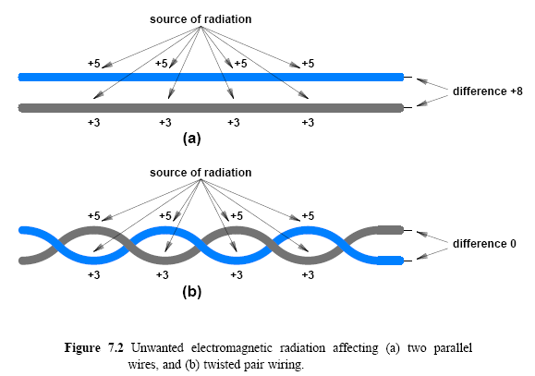
Twisted Pair Copper Wiring

Slide 9
Twisted Pair Copper Wiring
When two wires are in parallel
The distance to the source of electromagnetic radiation may differ
Different amount of electromagnetic radiation

Slide 10
Shielding: Coaxial Cable and Shielded Twisted Pair
Limitations on twisted pair wiring
strong electrical noise
high frequencies used for communication
Interference may occur
on top of a fluorescent light fixture
Distinguishing valid signals from noise can be difficult

Slide 11
Shielding: Coaxial Cable and Shielded Twisted Pair
Extra metal shielding wiring
Coaxial cable (coax): the wiring has a thick metal shield formed from braided wires that completely surround a center (inner) wire that carries the signal
A coaxial cable can stand electrical noise and high frequencies
The shield provides a barrier to electromagnetic radiation

Slide 12
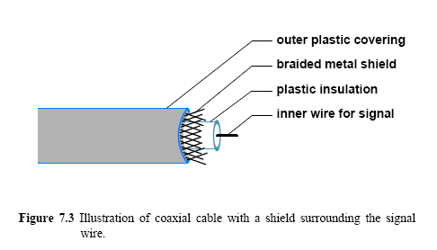
Shielding: Coaxial Cable and Shielded Twisted Pair

Slide 13
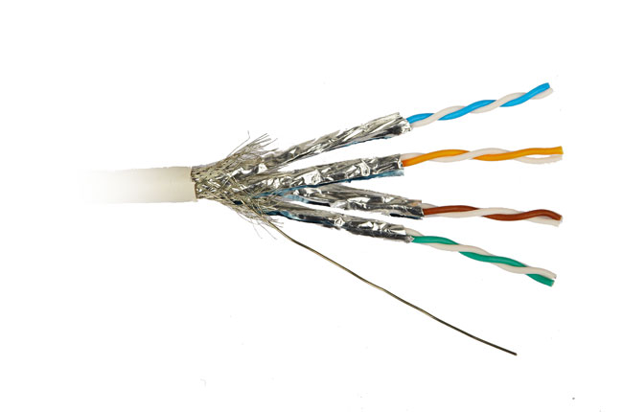
Shielding: Coaxial Cable and Shielded Twisted Pair
braided wire makes coaxial cable flexible
One variation -> shielded twisted pair (STP)
Thinner
Flexible metal shield surrounding one or more twisted pairs of wires
the shield contains metal foil

Slide 14
Standards organizations
American National Standards Institute (ANSI)
Telecommunications Industry Association (TIA)
Electronic Industries Alliance (EIA)

Slide 15
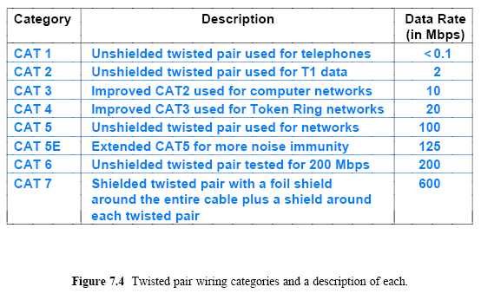
Categories of Twisted Pair Cable
CAT 8 fully shielded twisted pair - data center / 40 Gbps
High-performance network

Slide 16
Media Using Light Energy and Optical Fibers
three forms of media
Optical fibers: most widely used
InfraRed transmission
Point-to-point lasers
Each fiber consists of
A thin strand of glass or
transparent plastic encased in a plastic cover
An optical fiber for a single direction
two-way communication -> two fibers

Slide 17
Media Using Light Energy and Optical Fibers
Light can change direction
the boundary between two substances
For a given pair of substances
there exists a critical angle, θ
If (the angle of incidence = the critical angle)
travel along the boundary
If (the angle of incidence < θ )
refracted
If (the angle > θ )
reflected

Slide 18
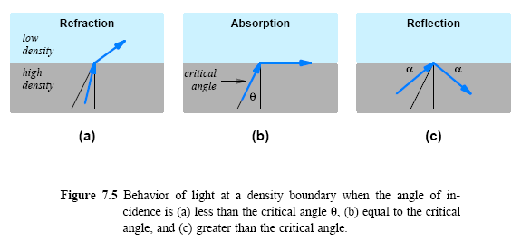
Media Using Light Energy and Optical Fibers

Slide 19
Media Using Light Energy and Optical Fibers
Reflection is not perfect
Reflection absorbs some energy
A photon may take a zig-zag path
Dispersion over time
Dispersion is a serious problem for long optical fibers

Slide 20
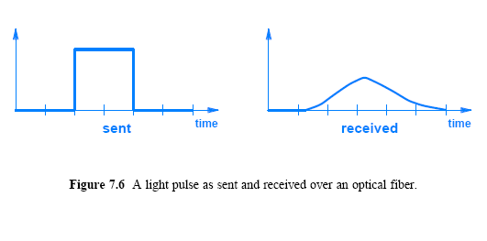
Media Using Light Energy and Optical Fibers

Slide 21
Types of Fiber and Light Transmission
Three forms of optical fibers :
Multimode, Step Index
used when performance is unimportant
reflect frequently, high dispersion
Multimode, Graded Index
increase density near the edge -> reduce reflection and lower dispersion
Single Mode
provides the least dispersion
smaller diameter and properties that help reduce reflection
used for long distances and higher bit rates

Slide 22
Types of Fiber and Light Transmission
Single mode fiber: focus light
can travel long distances without becoming dispersed
Minimal dispersion could increase the bit rate
Transmission: LED or Injection Laser Diode (ILD)
Reception: photo-sensitive cell or photodiode
LEDs and photo-sensitive cells
short distances and slower bit rates
common with multimode fiber;
single mode fiber
long distance with high bit rates
requires ILDs and photodiodes

Slide 23
Optical Fiber Compared to Copper Wiring
Comparison between Optical fiber and copper wiring
Optical fiber
immune to electrical noise
higher bandwidth
Travelling light does not attenuate as much as electrical signals traveling across copper
Copper wiring
less expensive
Installation is easy
Copper wires are less likely to break if accidentally pulled or bent

Slide 24
Infrared (IR) Communication Technologies
IR (e.g. TV remote)
a form of electromagnetic radiation
behaves like visible light but not visible to a human eye
Disperses quickly
Can reflect from a smooth, hard surface
Any opaque object can block the signal
IR commonly used to connect to a nearby peripheral
The wireless aspect of infrared can be attractive for laptop computers

Slide 25
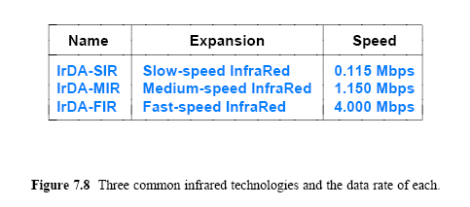
Infrared (IR) Communication Technologies

Slide 26
Point-to-Point Laser Communication
Requires line-of-sight
Laser follows line-of-sight
the beam is only a few centimeters wide
The sending and receiving equipment must be aligned
Used for outdoors and offers great distances
useful in cities to transmit from building to building

Slide 27
Electromagnetic (Radio) Communication
Most common form of unguided communication
Radio Frequency (RF) range
RF energy
Traverse long distances
Penetrate solid objects
The properties depend on the frequency
Regulating Organization
Federal Communications Commission (FCC) sets rules for how frequencies

Slide 28
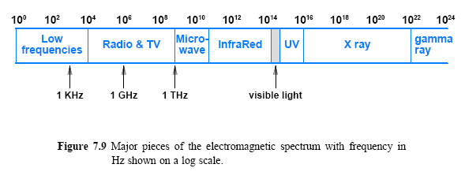
Electromagnetic (Radio) Communication
RF range (3KHz – 300GHz)

Slide 29
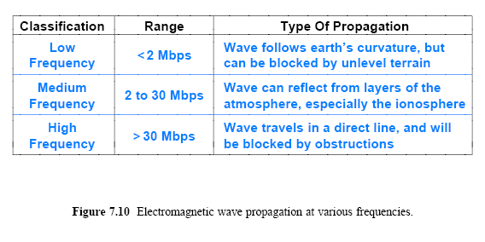
Signal Propagation

Slide 30
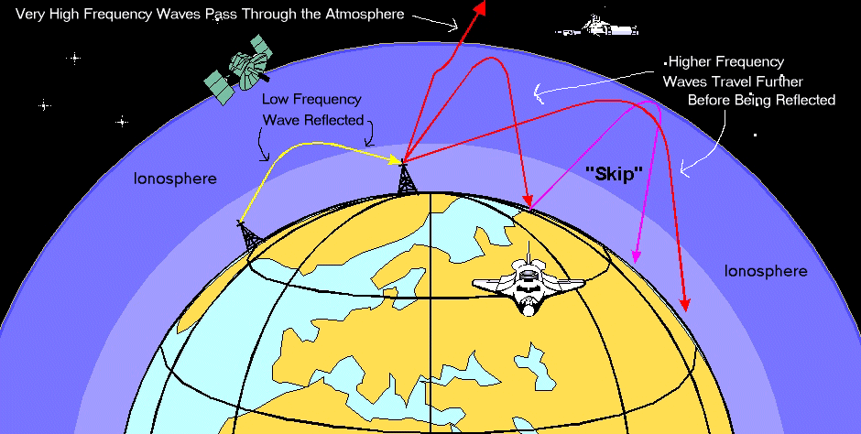
NASA

Slide 31
Signal Propagation
two broad categories as in wireless comm.:
Terrestrial
Non-terrestrial
Frequency and amount of power used can affect:
The speed
The maximum distance
Characteristics (penetrate solid object?)

Slide 32
Types of Satellites
The laws of physics (specifically Kepler's Law) applied to a satellite, that orbits the earth
The orbital period depends on the distance from the earth
three broad categories
LEO, MEO, GEO

Slide 33
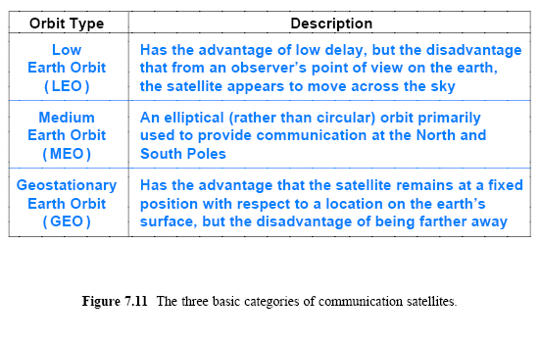
Types of Satellites

Slide 34
GEO Communication Satellites
GEO
the orbital period is the same as the earth
If positioned above the equator
a GEO satellite remains in one position
A stationary satellite position
Once aligned the equipment never needs to move

Slide 35
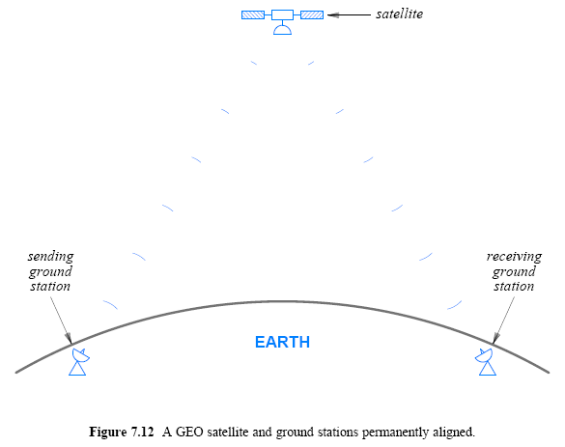
GEO Communication Satellites

Slide 36

GEO Communication Satellites
The distance required for a geostationary orbit is 35,785 kilometers or 22,236 miles
which is approximately one tenth the distance to the moon
Time to travel to GEO satellite
A delay of approximately 0.2 seconds can be significant for some applications

Slide 37
GEO Coverage of the Earth
How many GEO communication satellites are possible?
There is a limited amount of “space” available in the geosynchronous orbit above the equator
Frequency separation to avoid interference
the minimum separation depends on the power of the transmitters
However, as technology is evolving it’s possible to allocate more satellites in orbit

Slide 38
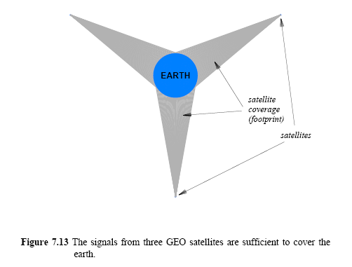
GEO Coverage of the Earth
*Drawn to scale

Slide 39
Low Earth Orbit (LEO) Satellites and Clusters
Low Earth Orbit (LEO)
up to 2000 Km typically at altitudes of 500-600 kilometers or higher (above atmosphere)
short delays (typically 1 to 4 ms)
The disadvantage of LEO
the orbit does not match the rotation of the earth
From an observer's point of view on the earth
an LEO satellite appears to move across the sky
Needs rotating antenna to track the satellite
Tracking is difficult because satellites move rapidly
The orbit between 90 minutes and several hours depends on altitude

Slide 40
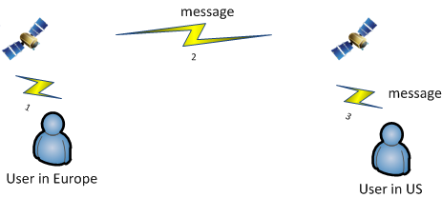
Low Earth Orbit (LEO) Satellites and Clusters
LEO satellites used in clustering or in array deployment
Communicate each other
For example,
Same group

Slide 41
Tradeoffs Among Media Types
The choice of medium is complex
Choice involves the evaluation of multiple factors, such as:
Cost
materials, installation, operation, and maintenance
Data rate
number of bits per second that can be sent
Delay
time required for signal propagation or processing
Affect on signal
attenuation and distortion
Environment
susceptibility to interference and electrical noise
Security
susceptibility to eavesdropping

Slide 42
Measuring Transmission Media
The two measures of performance for medium:
Propagation delay
the time required for a signal to traverse the medium
Channel capacity
the maximum data rate that the medium can support
Nyquist Theorem
The relationship between the bandwidth of a transmission system and its capacity to transfer data
Defines the maximum data rate without considering the effect of noise
K possible signal levels, analog bandwidth B, the maximum data rate in bits per second, D,

Slide 43
The Effect of Noise on Communication
Nyquist's Theorem cannot be achieved in practice due to electrical noise
Claude Shannon extended Nyquist's work to specify the maximum data rate with noise
Shannon's Theorem
where
C is the effective limit on the channel capacity in bits per second
B is the hardware bandwidth
S/N is the signal-to-noise ratio, the ratio of the average signal power divided by the average noise power

Slide 44
The Effect of Noise on Communication
Consider a transmission medium:
a bandwidth of 1 KHz (typical wi-fi is 20MHz, linear SNR is 1000)
an average signal power of 70 units
an average noise power of 10 units
The channel capacity is:
The signal-to-noise ratio is often given in decibels (abbreviated dB), where a decibel is defined as a measure of the difference between two power levels
Figure 7.14 illustrates the measurement

Slide 45
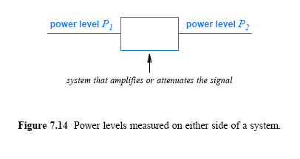
The Effect of Noise on Communication

Slide 46

The Effect of Noise on Communication
the difference is expressed in decibels, defined as follows:
Using dB as a measure has two interesting advantages:
First, it can give us a quick idea about outcome of an operations:
a negative dB value: attenuated
a positive dB value: amplified
Second, if a communication system has multiple parts arranged in a sequence
The dB measures of the parts can be summed to produce a measure of the overall system

Slide 47
The Effect of Noise on Communication
Example:
The voice telephone system:
S/N approximately 30 dB
an analog bandwidth of approximately 3000 Hz
To convert signal-to-noise ratio dB into a simple fraction
divide by 10 and use the result as a power of 10
(i.e., 30/10 = 3, and 10³ = 1000, so the signal-to-noise ratio is 1000)
Shannon's Theorem applied to the telephone network:
or approximately 30,000 bps
S/N dominates data rate

Slide 48
The Significance of Channel Capacity
Nyquist's work
Showed possibility of improving data rate with encoding technique
Shannon's Theorem
Showed fundamental limit on date rate in a real communication system -> the laws of physics

